Slide 1

YouTube Comment Abusivity Analyzer
Yuthikshaa M (2021115123), Abinaya S (2021115004), Karthika P (2021115049)
Under the Guidance of
Dr. M. Deivamani
Academic Session : August 2023 – November 2023

Slide 2
Problem statement
Abusive speech causes severe psychological effects on the targeted individual. These abusive comments also can create controversy over social media on a specific individual or a group of people.
This shows the need for restricting these kinds of abusive comments from being posted on social media (like YouTube).
Therefore, there is a need to develop a model that can detect and label such abusive comments.

Slide 3
Literature Survey
AUTHOR | TITLE OF PAPER | JOURNAL/ CONFERENCE NAME | PROS | CONS
F. A. Rawther and G. Titus | Transformer Models for Recognizing Abusive Language An investigation and review on Tweeteval and SOLID dataset | Second International Conference on Electrical, Electronics, Information and Communication Technologies (ICEEICT),2023 | Highlights the social implications of abusive language | Limits its generalizability to languages other than English
S. Naik and A. Katre | YouTube Universe of Comments: A Machine Learning approach for systematic classification of YouTube Comments on custom prepared dataset | World Conference on Communication & Computing (WCONF),2023 | Assesses the generalizability by conducting experiments on different genres on youtube videos | May not be entirely generalizable to other social media platforms

Slide 4
Literature Survey
AUTHOR | TITLE OF PAPER | JOURNAL/ CONFERENCE NAME | PROS | CONS
S. Chiramel, D. Logofatu and G. Goldenthal | Detection of social media platform insults using Natural language processing and comparative study of machine learning algorithms | 24th International Conference on System Theory, Control and Computing (ICSTCC),2020 | Provides a comparative analysis of Machine Learning algorithms | Difficult to assess the research’s methodology

Slide 5
System Architecture
Input
API key and video link of youtube
Data Preparation
Gathering Youtube comments
Lowercasing
Data Preprocessing
Tokenization
Stopword removal
Checking abusivity
Punctuation removal
Data Preparation
Store comment data in dictionary
Special Character removal
Appending comment data to list of abusive comments
Stemming and
Lemmatization
Labelling the abusive and non-abusive comments
Data Preparation
Contract expansion
Normalization

Slide 6
Module Description and algorithms planned to use
The approach doesn't explicitly mention a specific algorithm for detecting abusive comments. However, it outlines a series of preprocessing steps and methods commonly used in NLP and text analysis.
Module 1: User Interface
Description:
Intuitive web forms capture YouTube video links and user details for analysis and contact.
A user-friendly navigation bar simplifies exploration across Home, About, Team, and Contact sections.
Real-time feedback is provided through flash messages for improved user interaction.
Comment analysis results are presented in a clear and organized format, enhancing system usability.

Slide 7
Module Description and algorithms planned to use
Module 2: Input handling
Description:
This module efficiently manages user interactions by capturing and validating form submissions for video analysis and contact messages.
It seamlessly integrates with the YouTube API to retrieve comments based on user-provided video links.
Additionally, the module processes contact form submissions by forwarding user messages to the designated email address, ensuring effective communication.

Slide 8
Module Description and algorithms planned to use
Module 3: Preprocessing of comments
Description:
Performing tokenization, stopwords, punctuation and special character removal, stemming, lemmatization, contraction expansion on the comments.
Abusive Keyword Detection: Read a list of abusive keywords from a text file and check if comment tokens contain any of the abusive keywords.
Comment Preprocessing: Remove URLs from comments.
Normalization (Synonym Mapping): Map words to their synonyms using WordNet.

Slide 9
Module Description and algorithms planned to use
Module 4: Output Generation
Description:
The Output Generation Module serves a crucial role by categorizing comments as abusive or not, enabling efficient reporting to YouTube.
This functionality, aimed at fostering a safer online environment, recommends the disabling of comment sections for the well-being of both content creators and YouTube users.

Slide 10
Module Description and algorithms planned to use
Module 5: Error handling and Exception Reporting
Description:
The Error Handling Module validates user input, ensuring accurate video links and form submissions and gives informative error messages.
It monitors YouTube API integration for seamless comment retrieval, minimizing potential errors.

Slide 11
Deliverables
User friendly application with self-description (About), Team pages and clear navigation
Input API key and YouTube video link
Comment analysis results in an organized format, indicating the presence of abusive content.
Contact page features real-time flash messages for immediate user feedback.

Slide 12
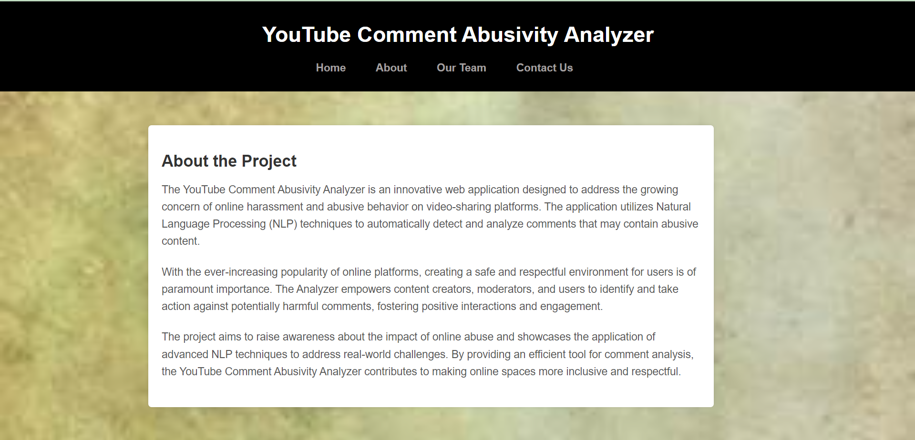
Sample Screenshot
1. About page

Slide 13
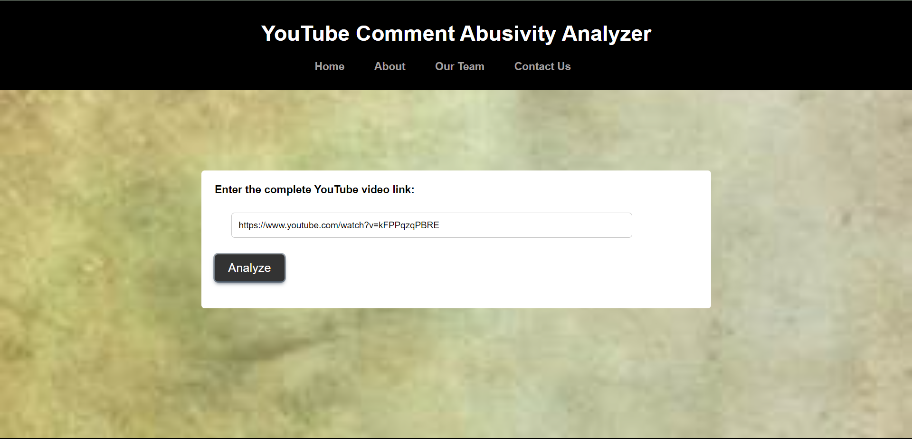
Sample Screenshot
2. Video link input

Slide 14
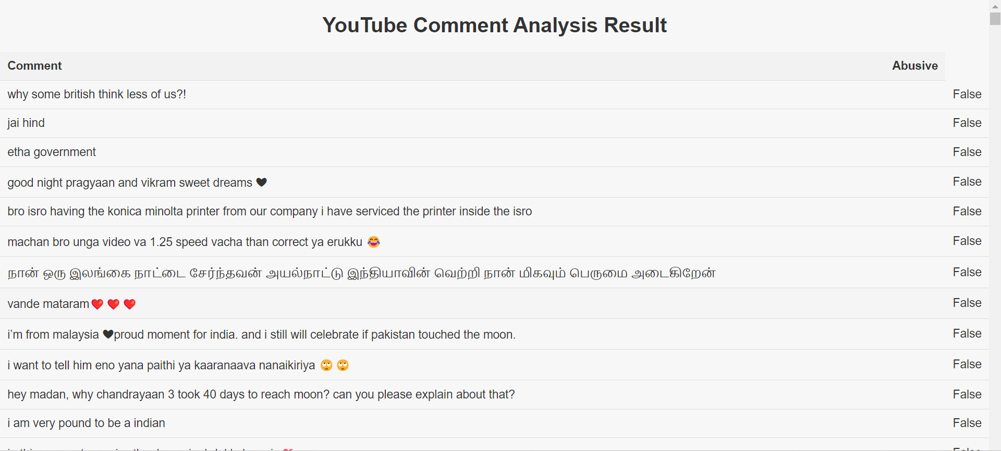
Sample Screenshot
3. Abusivity detection of comments

Slide 15
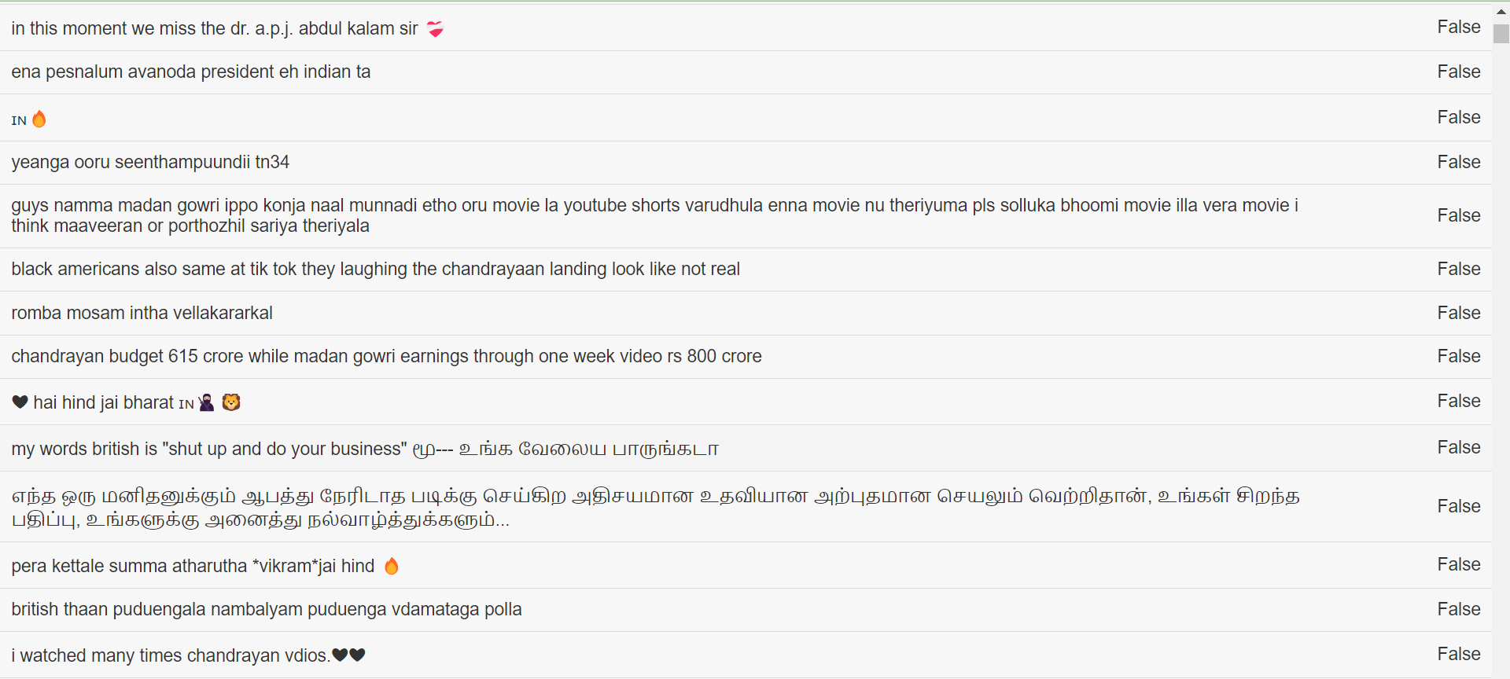
Sample Screenshot
3. Abusivity detection of comments

Slide 16
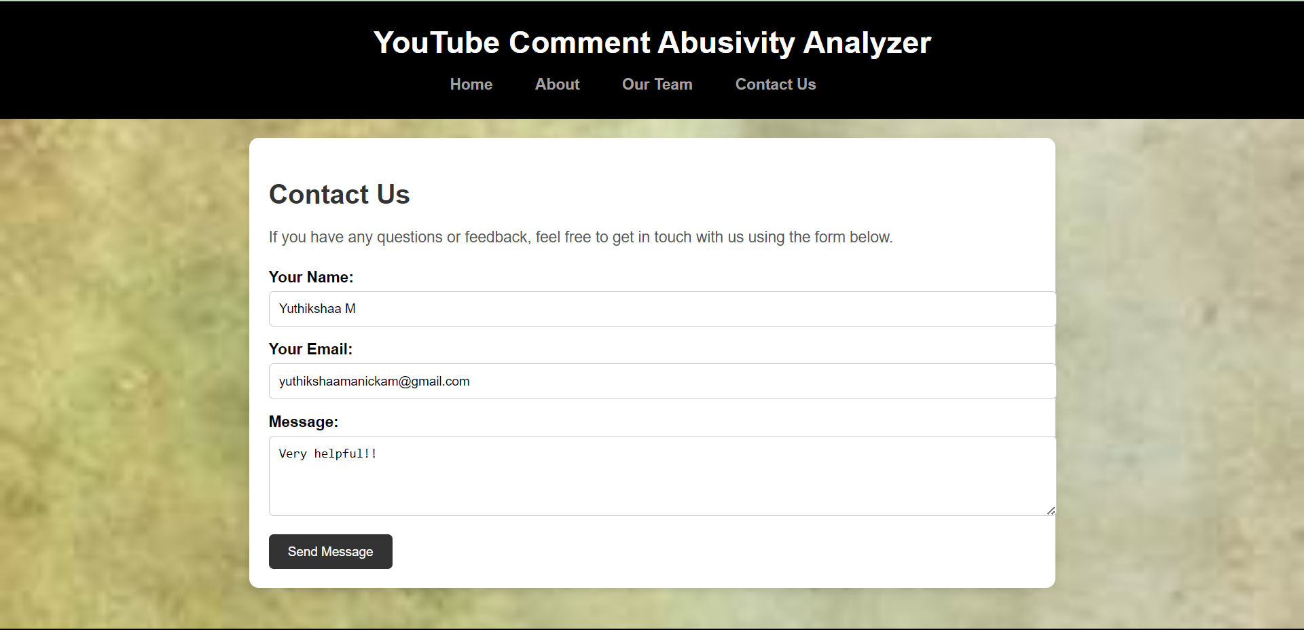
Sample Screenshot
4. Contact page

Slide 17
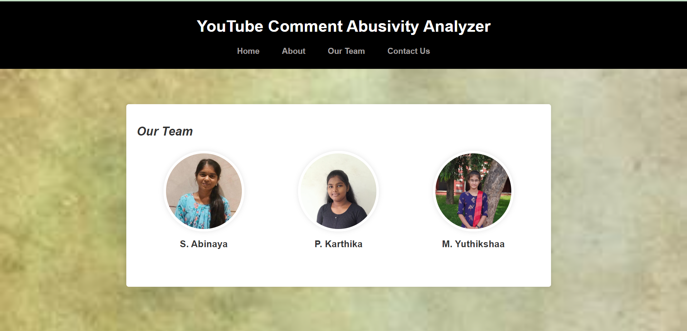
Sample Screenshot
5. Team page

Slide 18
Tools and Technologies
Flask
NLTK (Natural Language Toolkit)
Wordnet
Contractions
Formspree
SMTP

Slide 19
REFERENCES:
F. A. Rawther and G. Titus, "Transformer Models for Recognizing Abusive Language An investigation and review on Tweeteval and SOLID dataset," Second International Conference on Electrical, Electronics, Information and Communication Technologies (ICEEICT), India, pp. 1-6, 2023.
S. Naik and A. Katre, "YouTube Universe of Comments: A Machine Learning approach for systematic classification of YouTube Comments on custom prepared dataset,"World Conference on Communication & Computing (WCONF), pp. 1-5,2023.
S. Chiramel, D. Logofătu and G. Goldenthal, "Detection of social media platform insults using Natural language processing and comparative study of machine learning algorithms," 24th International Conference on System Theory, Control and Computing (ICSTCC), pp. 98-101, 2020.

